Slide 1
CUSTOMER SATISFACTION – ISSUES AND ANALYSIS:
A COMPARATIVE STUDY IN TELECOMMUNICATION INDUSTRY
Under the guidance of Professor Rong Liu
Course: BIA 660
Course Name: Web Mining
Presenter: Group 6

Slide 2
TEAM MEMBERS (GROUP 6)
Ankita Yadav
Oshin Mohabe

Slide 3
TOPICS COVERED
Introduction
Problem Description
Research Questions
Data Collection
Data Preprocessing
Exploratory Data Analysis
Methodology
Model Comparison
Insights and Analysis
Conclusion
Future Work
Reference

Slide 4

INTRODUCTION
During COVID – 19 pandemic, one piece of technology that kept everyone connected is the telecom services.
There has been a drastic increase in network usage services.
As per Statista, the top two wireless carrier/operator subscriber share in the U.S. 2020 are AT&T and Verizon.
AT&T is one of the oldest companies in the telephone business and has a market value estimated at approximately $209 billion.
Verizon provides wireless and wireline services in addition to broadband and information services and has a current market capitalization value of approximately $236 billion.

Slide 5


PROBLEM DESCRIPTION
During the time of COVID-19 classes are conducted online and work from home culture has increased tremendously.
Companies need to understand what product offerings and service features are important for the customers.
Understanding customer preference shall lead to improved service offerings, better customer service, and retention of old customers as well as attracting new customers.
The reviews of AT&T and Verizon are analyzed since they hold the highest market share in the United States.
Analyzing the reviews shall highlight the positive and negative features of the companies thus showcase the competitive advantage these companies hold over others in the industry.

Slide 6

RESEARCH QUESTIONS
The research shall enable the telecom companies to understand where they are lacking and therefore are unable to grab the top spot.
Through our research, we shall highlight a set of attributes that makes a company stand out from others and share key issues faced by the customers that need to be worked upon.

Slide 7
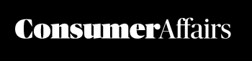
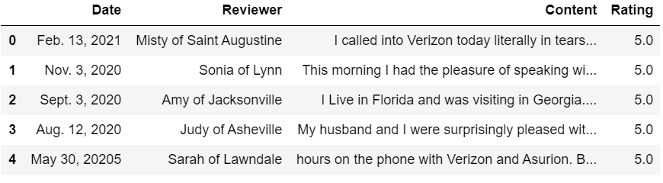
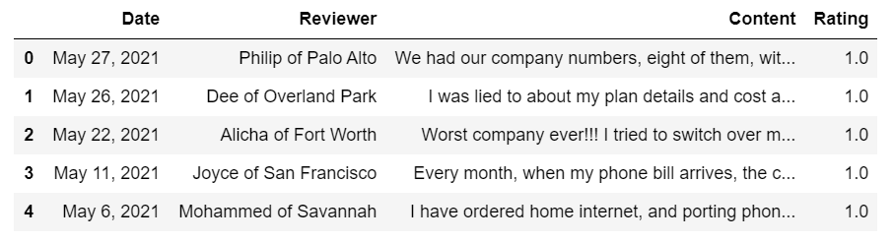
DATA COLLECTION
We have collected data from Consumer Affairs (https://www.consumeraffairs.com/).
Consumer Affairs provides verified reviews of customers of AT&T and Verizon.
A total of 13,749 reviews collected through web scraping.
Total of AT&T reviews is 6838.
Total of Verizon reviews is 6911.

Slide 8
DATA PREPROCESSING
Data Preprocessing
Date “object” type to “datetime64” datatype
Missing Values – Replaced Missing Values
Pandas Profiling – Detailed Information of Variables
Duplicated Data – Deleted the Rows
Deleted the Invalid Values
Created Training and Testing Dataset

Slide 9
EXPLORATORY DATA ANALYSIS
Comparison of Ratings
Length of Review Comparison
Normalization using Lemmatization Technique
Tokenization
Collocation using POS Tagging
(Adjective-Noun, Noun-Noun)
Naïve Based Sentiment Analysis
Feature Engineering using CountVectorizer

Slide 10
METHODOLOGY
Supervised sentiment analysis using word vectors to analyze the reviews as positive or negative.
Manual labeling and labeling based on rating has been done of dataset.
Use of two machine learning algorithm to train the classifier namely, Support Vector Machine and Naïve Bayes.
Support vector machine algorithm – A hyperplane is found in an N-dimensional space (N — the number of features) that distinctly classifies the data points.
Multinomial Naïve Bayes classification algorithm – Based on Bayes theorem with an assumption of independence among predictors.
Performance Evaluation is done through Confusion Matrix and Classification Report.

Slide 11
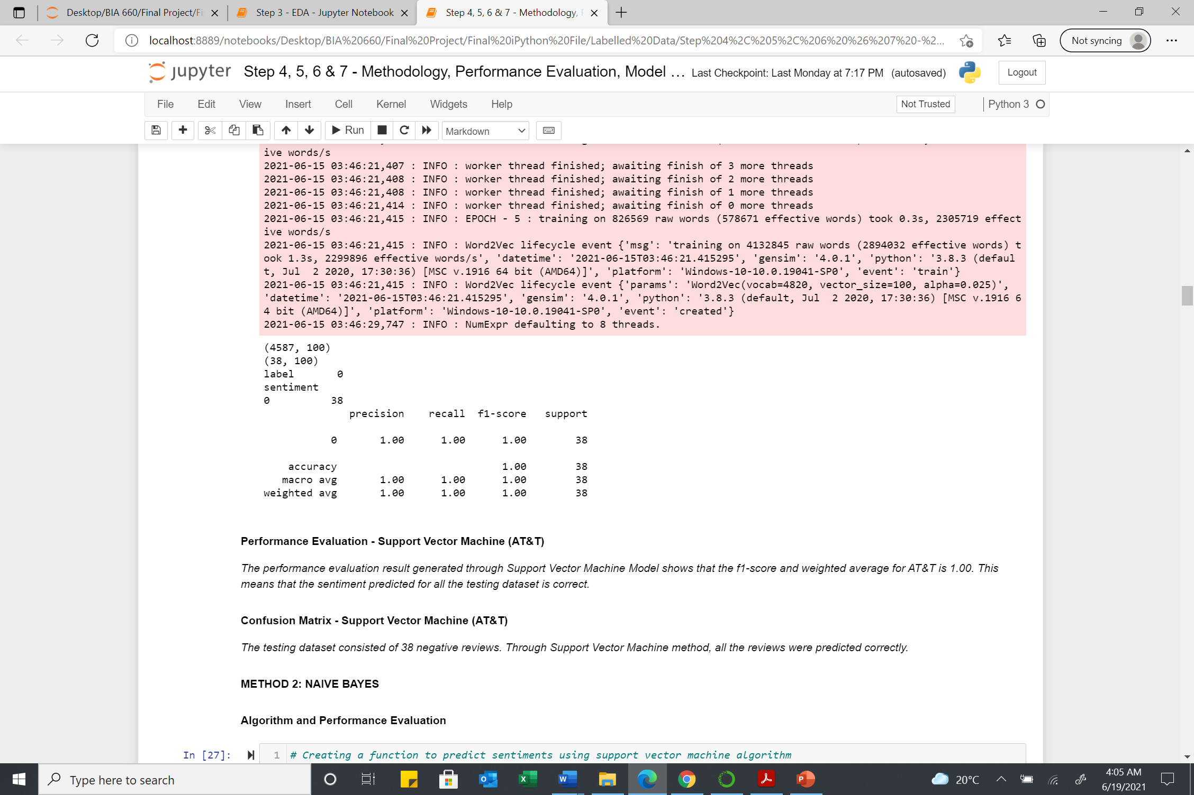
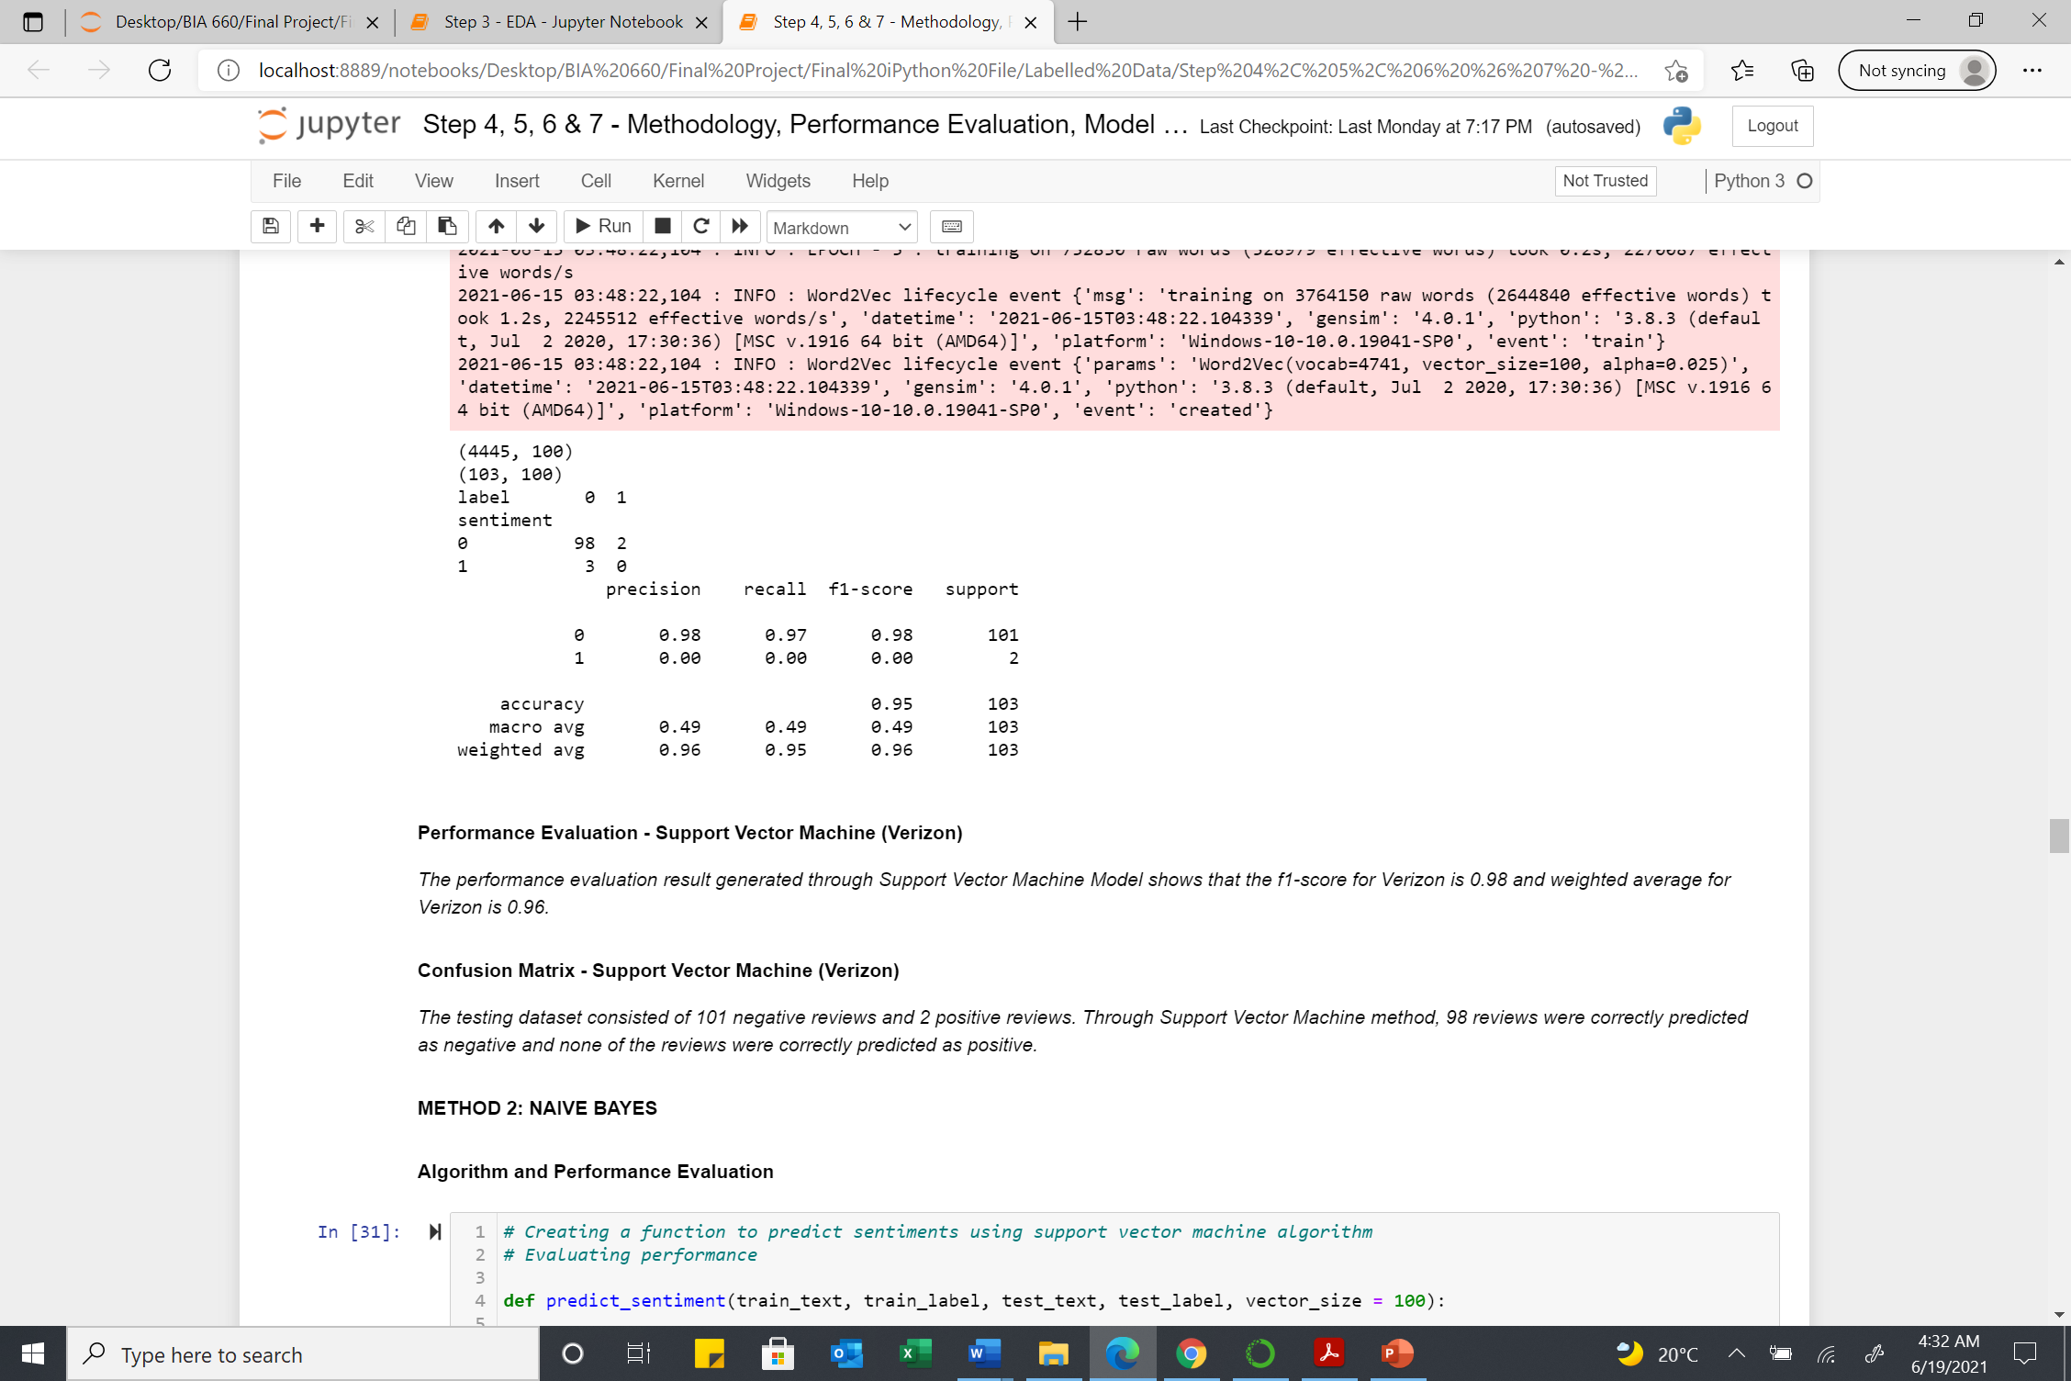
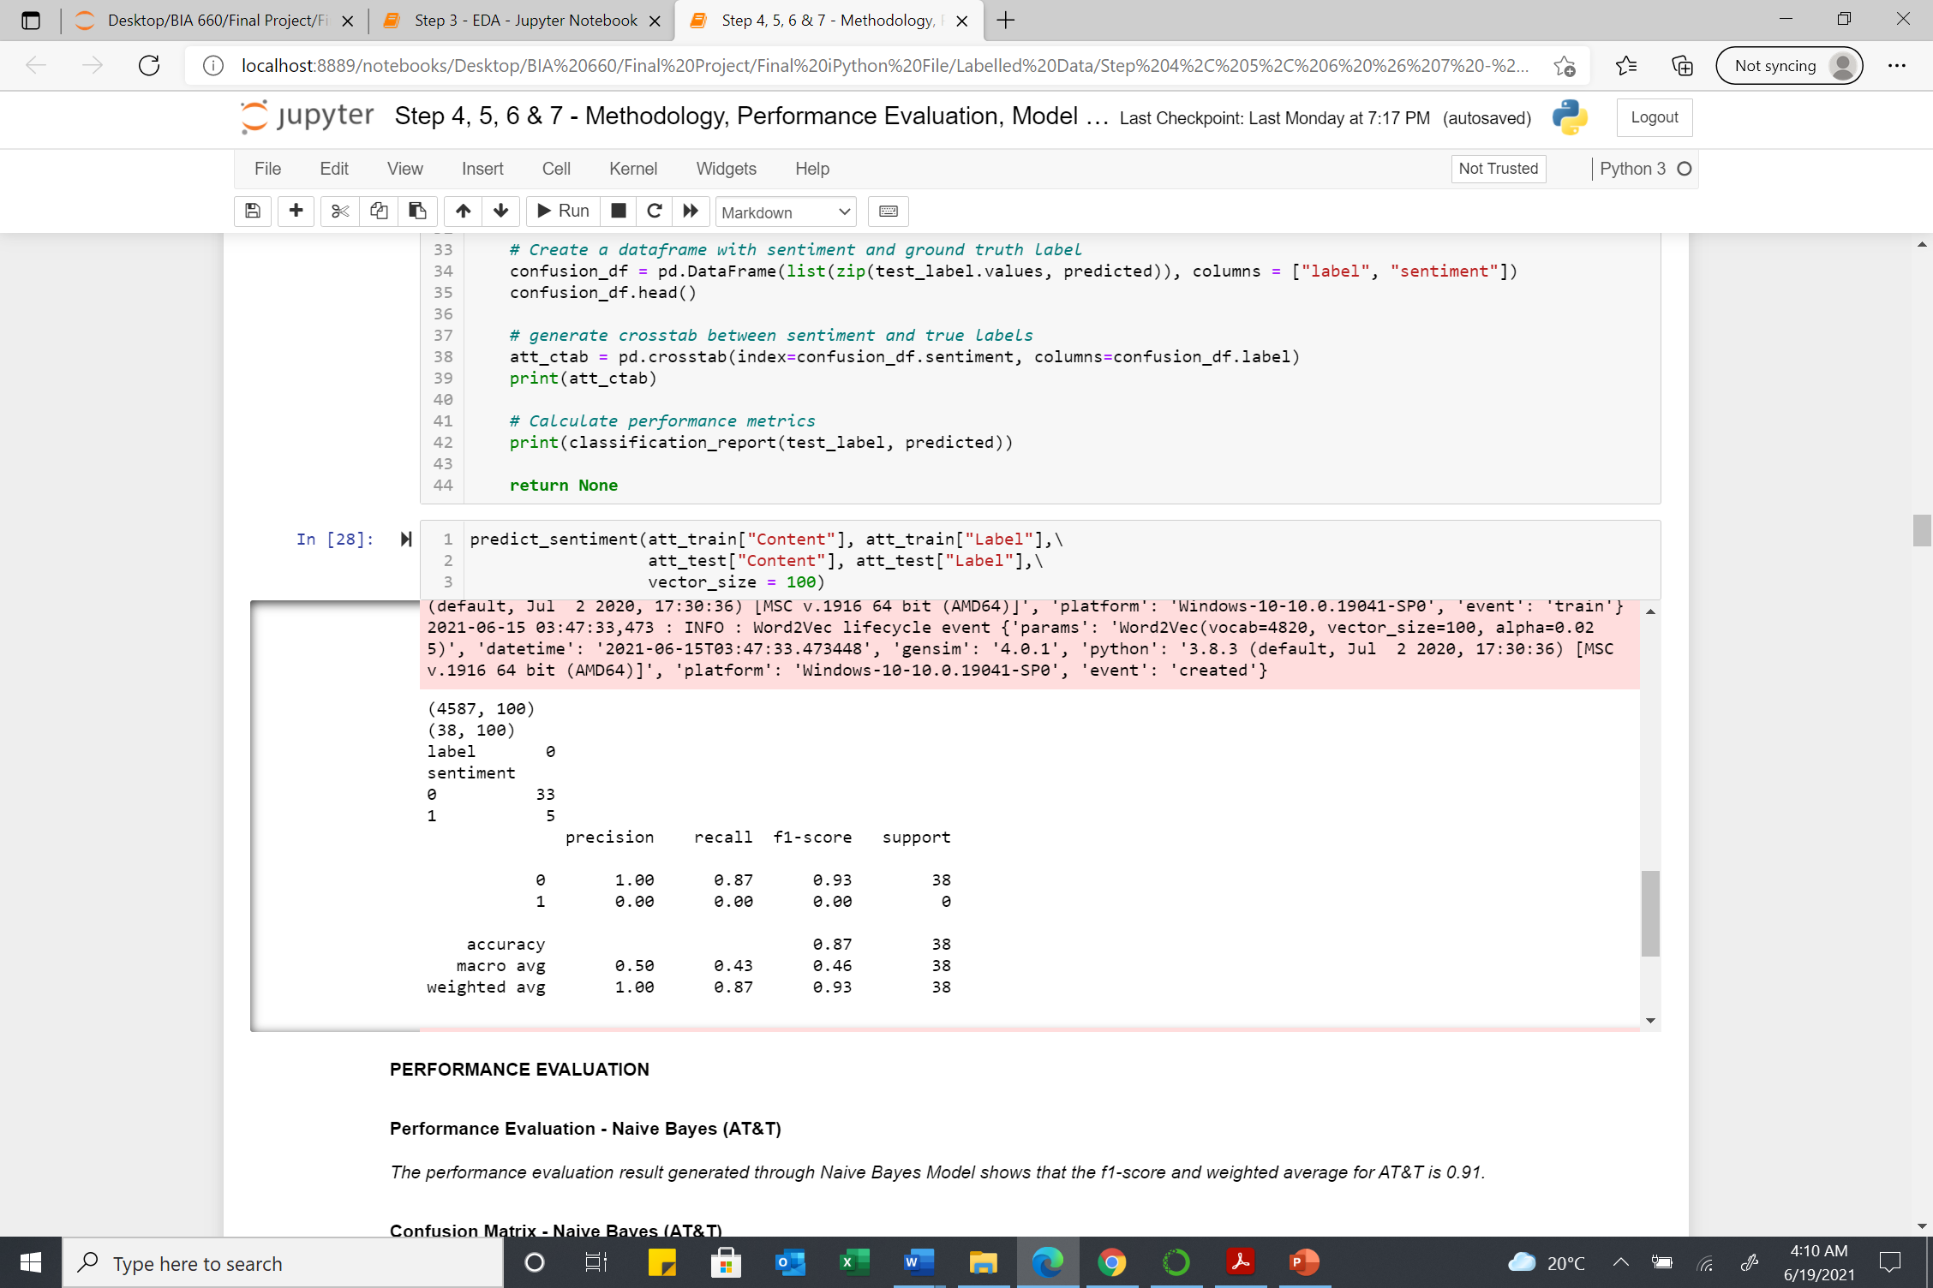
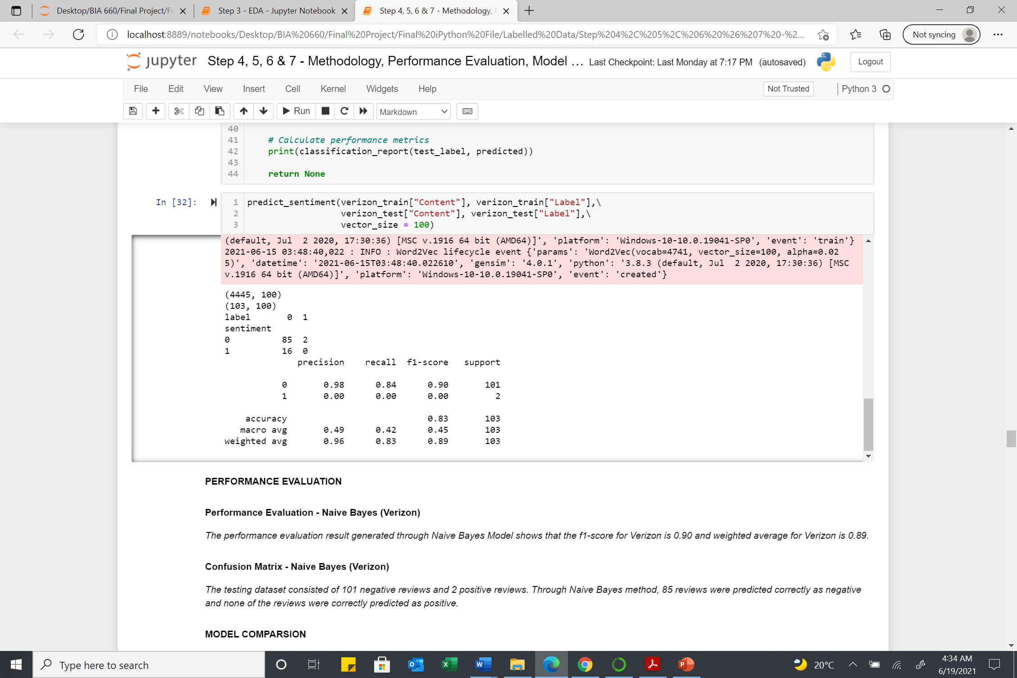
METHODOLOGY
Support Vector Machine
Naïve Bayes
AT&T
Verizon

Slide 12
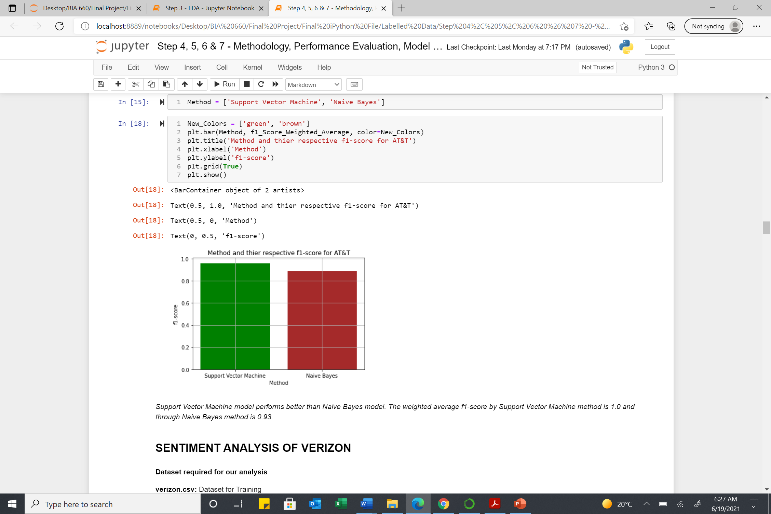
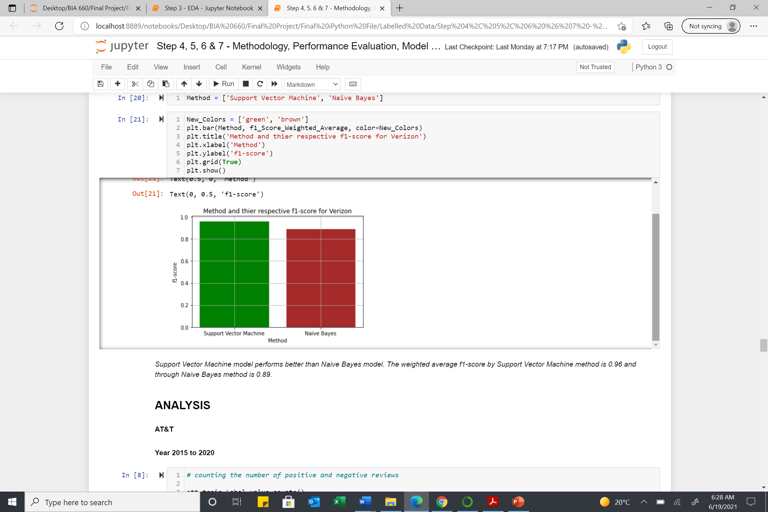
MODEL COMPARISON
The model support vector machine performed better than naïve bayes.
The f1 score (weighted average) through support vector model for AT&T is 1.00 and for Verizon is 0.96.
The f1 score (weighted average) through naïve bayes model for AT&T is 0.93 and for Verizon is 0.89.
AT&T
Verizon

Slide 13
INSIGHTS AND ANALYSIS
Most Discussed Topics
Customer Service, Internet Service, Data Plan, Billing Cycle
Customer Service, Data Plan, Unlimited Data, Service Rep, Tech Support
Positive Features
Easy Use, Great Deals, Excellent Service
Always Reliable, Extra Mile, Reliable Network, Reception Great, Service Reliable, Fit Budget, Great Plan, Great Experience, Rarely dropped, Good Selection
Area needs to be explored and given attention
Negative Feedback
Worst Experience, Poor Service, Service Issue, Poor Customer
Bad Experience, Poor Customer, Fraud Department, Poor Service
Verizon is appreciated more as compared to AT&T
Customer Service is one of the major issue faced by customers
AT&T
Verizon

Slide 14
CONCLUSION
Sentiment analysis is extremely useful in monitoring feedback, and it allows the companies to quickly gain an overview of the wider public opinion. This helps the companies in planning and strategizing.
From 2015 to 2020, Verizon has provided better overall service than AT&T based on count of positive and negative reviews and ratings.
From collocations and feature engineering it can be concluded, Verizon had a greater number of positive features when compared to AT&T.
In 2021, Verizon has received higher number of negative reviews when compared with AT&T.
Support vector machine model performed better than naïve bayes model in predicting the sentiments of the reviews.
The review with least rating is bigger in length as compared with reviews with high rating.

Slide 15
FUTURE WORK
Future Work
Telecom Industry based study
Geographical Information – Research based on different regions
Demographic Information – Research based on different age groups

Slide 16
REFERENCE
https://www.investopedia.com/ask/answers/070815/what-telecommunications-sector.asp
https://towardsdatascience.com/support-vector-machine-introduction-to-machine-learning-algorithms-934a444fca47
https://www.analyticsvidhya.com/blog/2017/09/naive-bayes-explained/
https://www.consumeraffairs.com/cell_phones/verizon_wireless.html
https://www.consumeraffairs.com/cell_phones/att_wireless.htm

Slide 17
THANK YOU

